Slide 1
PPT ON RFM MODELLING

Slide 2
INFORMATION OF THE DATA
Shape of the data = (5000,40)
Dimension of data = 2
Type of data = pandas DataFrame
Null values count = 0

Slide 3
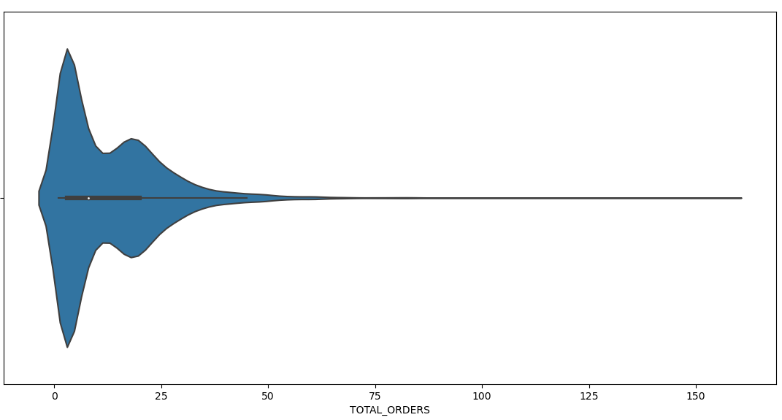
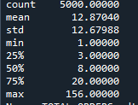
EDA
1) TOTAL ORDERS DETAILED INFORMATION
Violin plot of Total Orders.

Slide 4
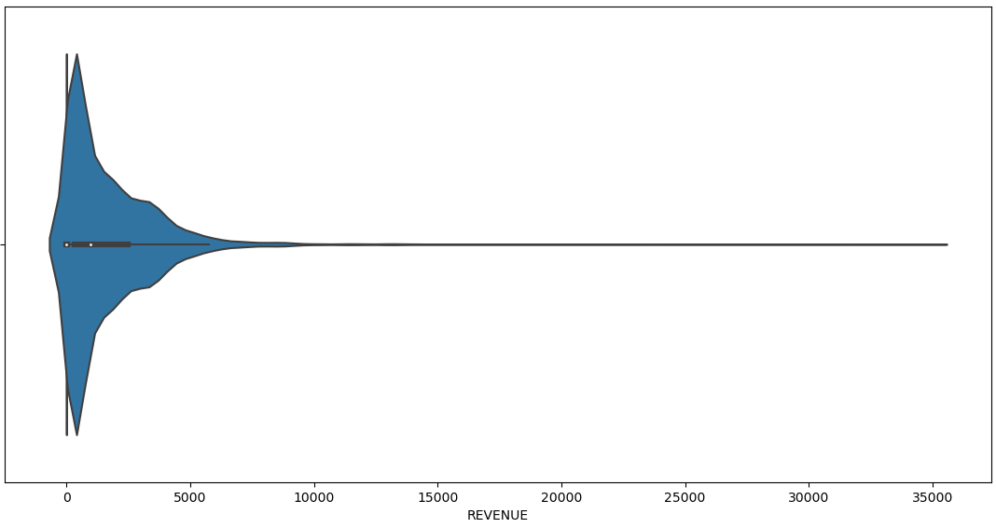
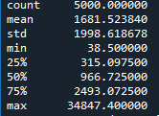
2) TOTAL REVENUE DETAILED INFORMATION
Violin plot of Total Revenue.

Slide 5
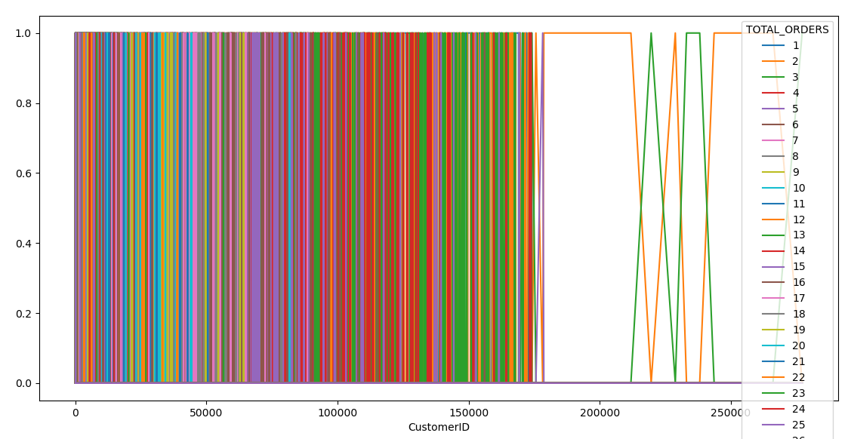
This plot shows that some customers have ordered very frequently

Slide 6
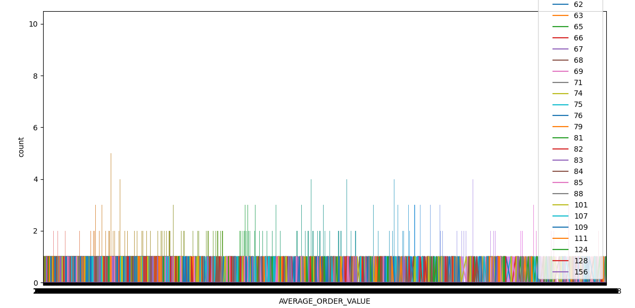
This plot help us to know that the highest order value is 156 i.e., some customers have ordered 156 items.

Slide 7
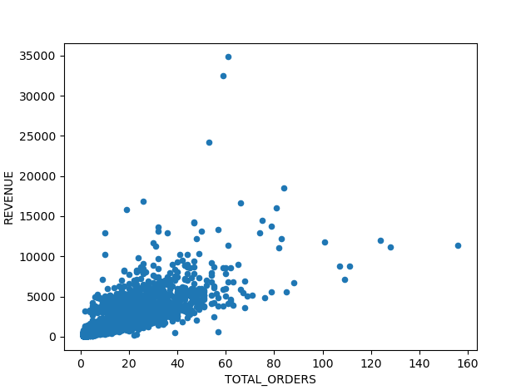
Scatter plot between Total Orders and Revenue shows that Revenue does not show any large change with the increasing number of orders. It means customer generally place order which cost around
0-10000 INR.

Slide 8
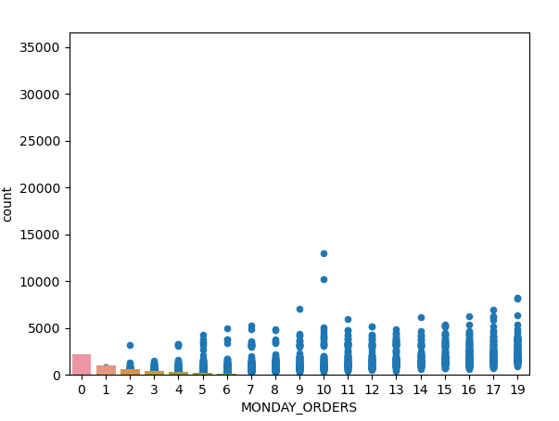
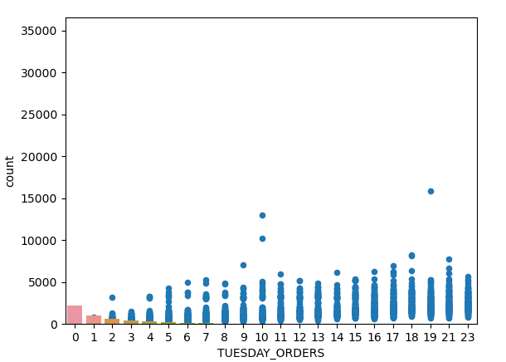
DAYWISE ORDER VISUALISATION

Slide 9
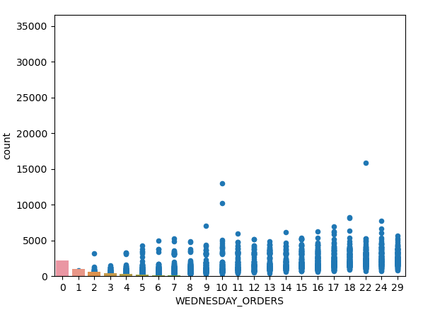
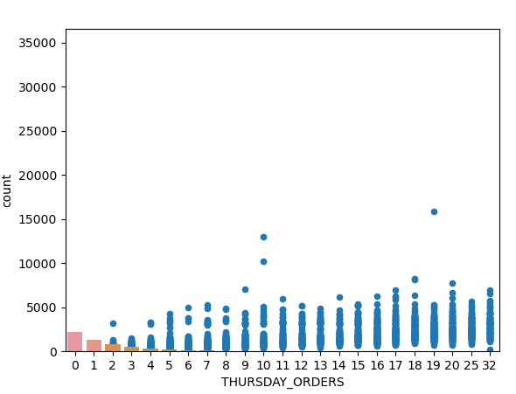

Slide 10
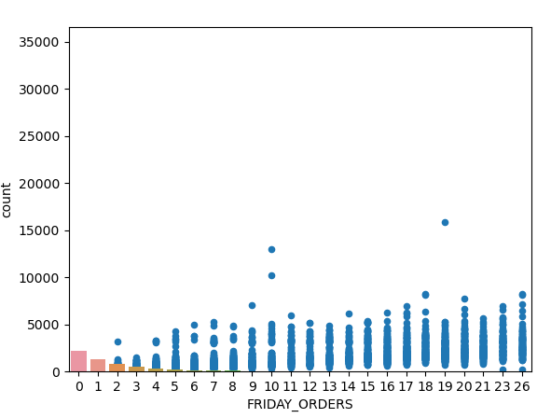
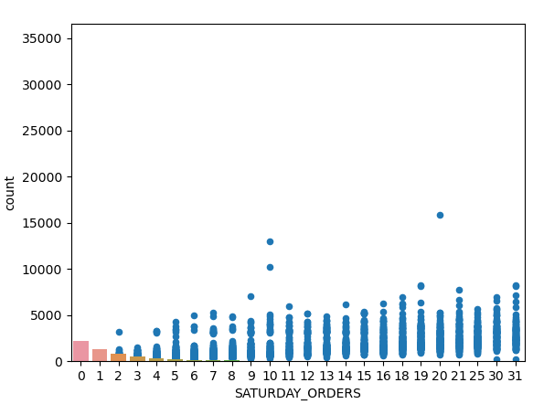

Slide 11
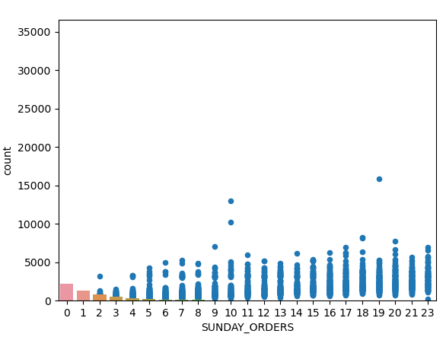
From the above graphs, it is clear that customer ordered more on Thursday, Saturday and Sunday.

Slide 12
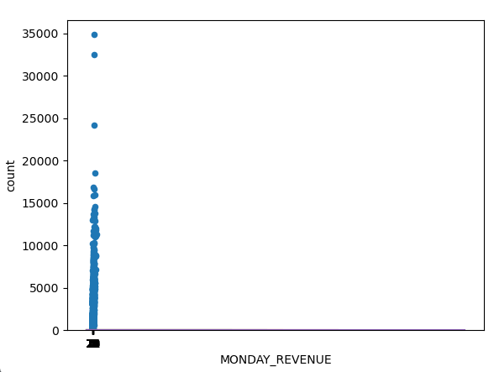
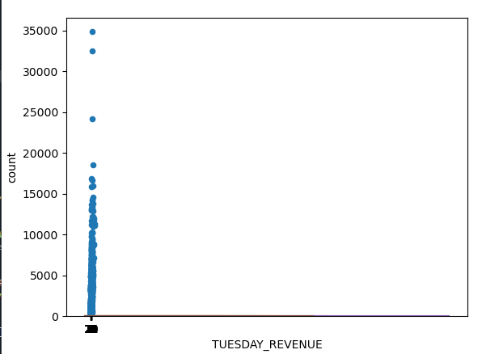
DAYWISE REVENUE VISULISATION

Slide 13
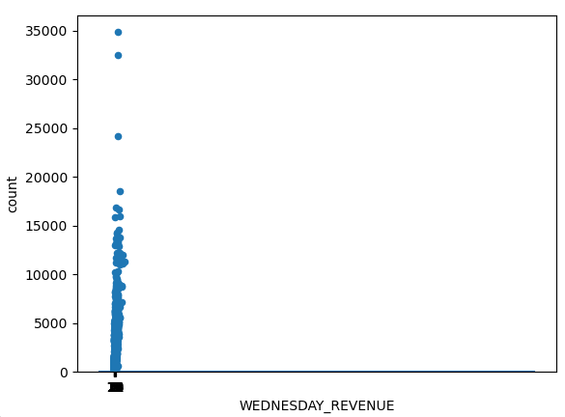


Slide 14
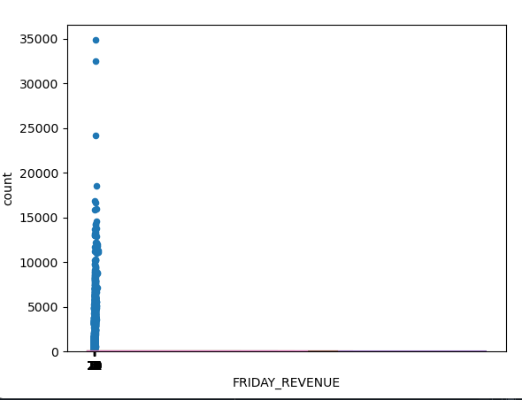
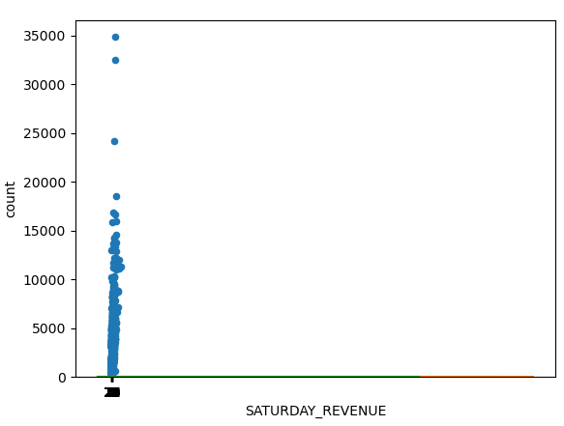

Slide 15
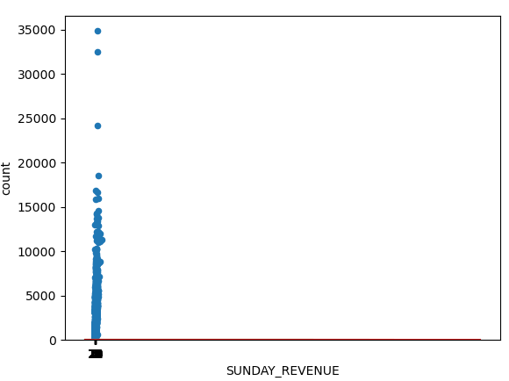
From day wise revenue visualisation, it is clear that customers order of cost up to 10000 on daily basis

Slide 16
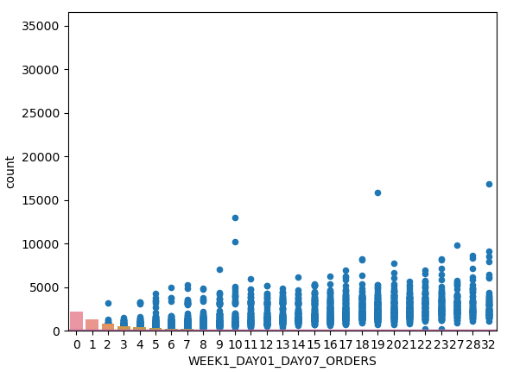
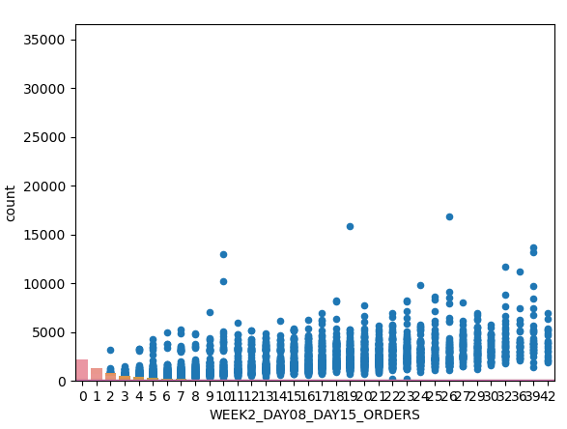
WEEKWISE ORDER VISUALISATION

Slide 17
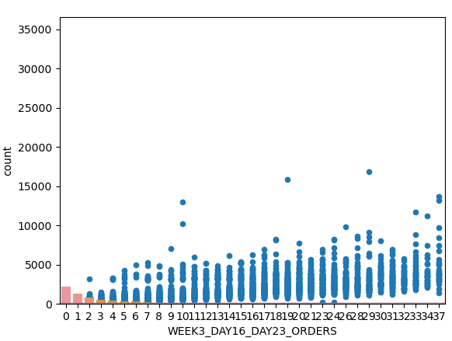
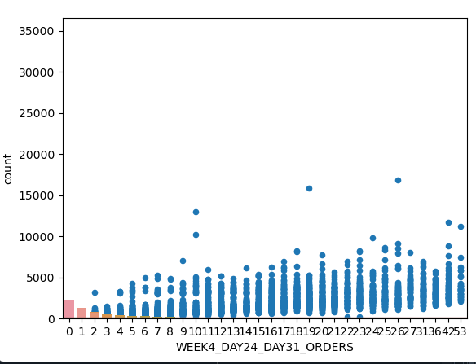

Slide 18
Week wise order visualisation tells us that the most order is done on week 2 and week 4

Slide 19
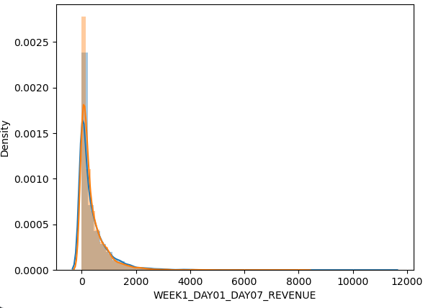
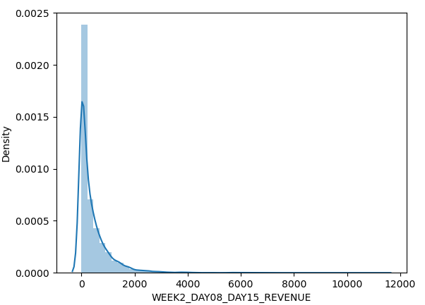
WEEKWISE REVENUE VISUALISATION

Slide 20
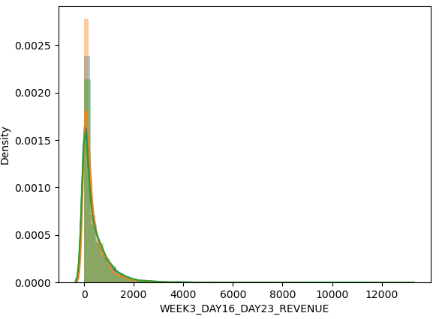
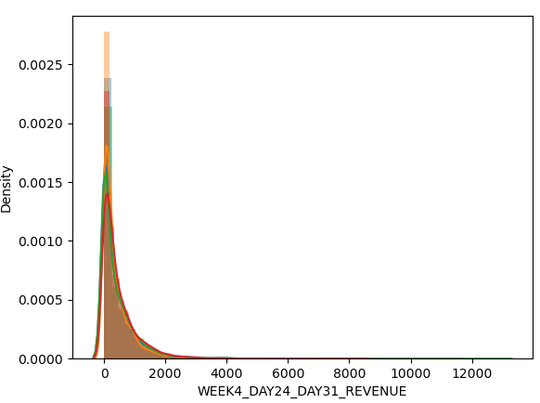

Slide 21
It is clear from the week wise revenue visualisation that in a week each customer order between the cost 0-2000

Slide 22
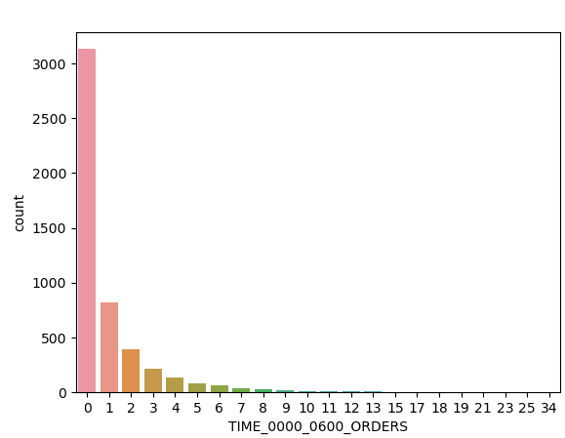
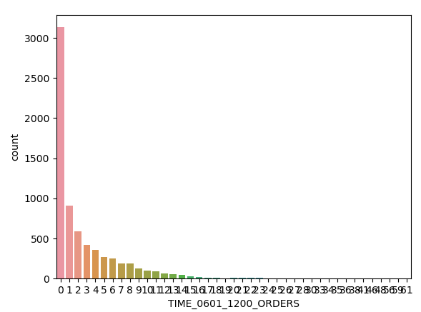
TIMEWISE ORDER VISUALISATION

Slide 23
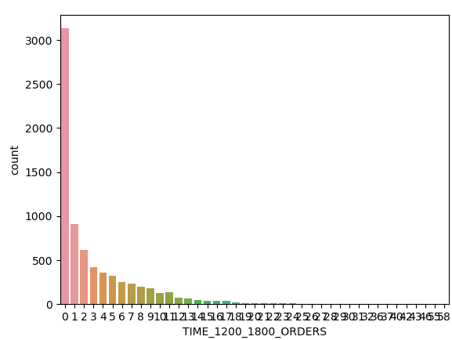
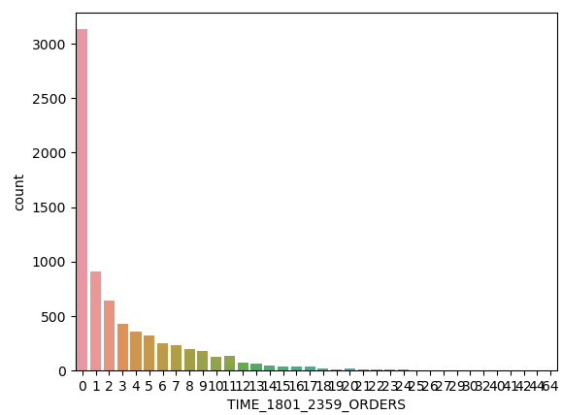

Slide 24
From time wise order visualisation we come know that the maximum order is placed between
18:01 – 23:59

Slide 25
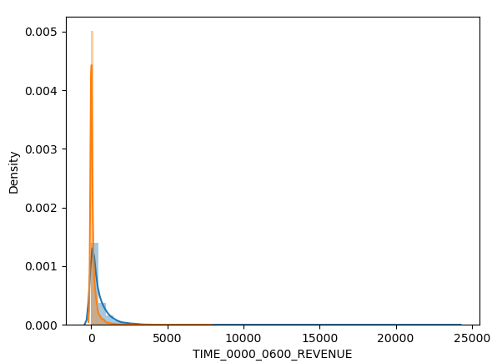
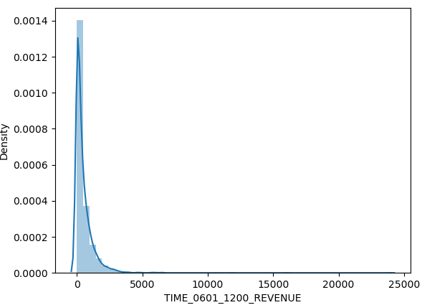
TIMEWISE REVENUE VISUALISATION

Slide 26
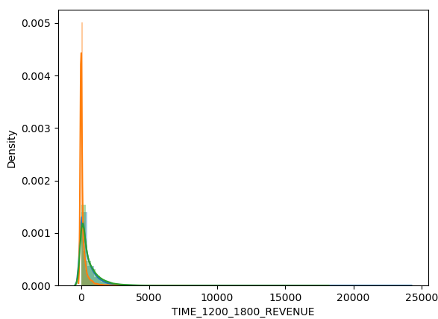
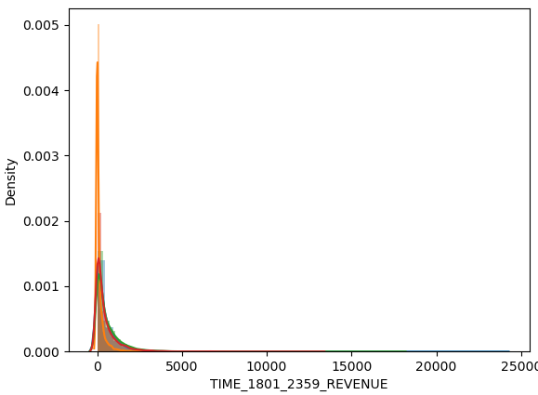

Slide 27
Time wise revenue visualisation shows that the customers have ordered of cost around 0-2000 mostly between the time period of
18:01 – 23:59.

Slide 28
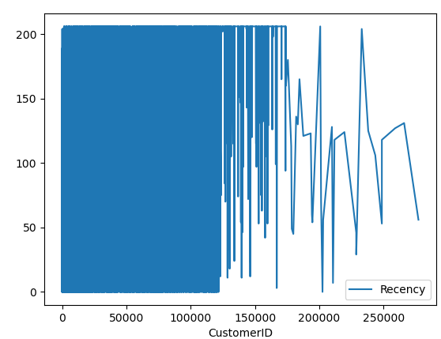
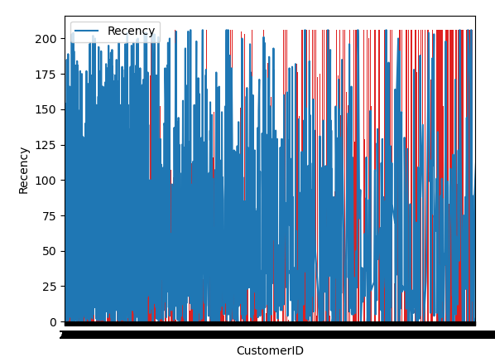
Recency score of the data.

Slide 29
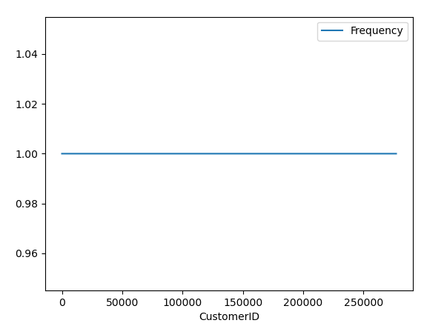
FREQUENCY SCORE
Here, the frequency score of the data is constant i.e., frequency score =1

Slide 30
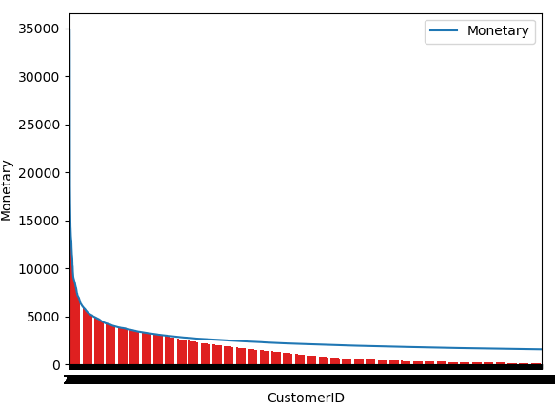
MONETARY SCORE
On an average the customer do the shopping of cost between 0-10000.

Slide 31
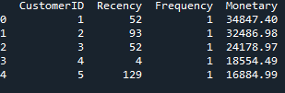
RFM TABLE

Slide 32
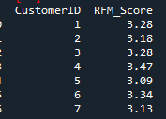
RFM SCORE

Slide 33
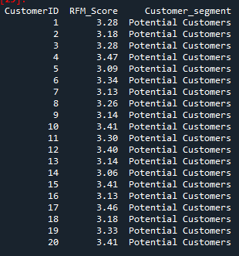
CUSTOMER SEGMENT

Slide 34
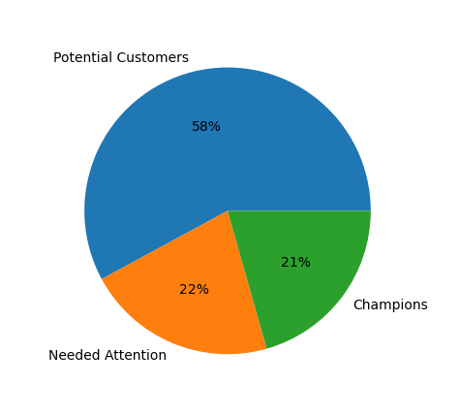
INFERENCE
Hence, 21% of customers are champions, 58% of customers are potential customers and 21% of customers are the customers who need attention

Slide 35
• What decision company should take based on the data insights?
ANS= On the basis of data more than 50% of customers are potential customers it means they have to work more on the customers who need attention and provide them offer time to time to increase their shopping interest and earn more profit through them.

Slide 36
THANK YOU

